Slide 1
Setting the context
CEO Pitch
Pitching to venture capitalist firm whose portfolio has breweries
Heavily invested in large volume breweries and not in brewpubs
We believe combination of restaurant \ brewery i.e. brew pub is another way to capture a new customer base and build loyalty
CMO – with strong background in data analytics
Wants to understand how can made this decision on a brewpub in Dallas
Prescriptive
Leverage Demographic (ArcGIS)
Untappd Monthly Check-Ins
Predictions
predict entry in to market by reviewing check-ins in a zip code, to determine if a brewery is sufficient
Loyalty
Throw out stats

Slide 2

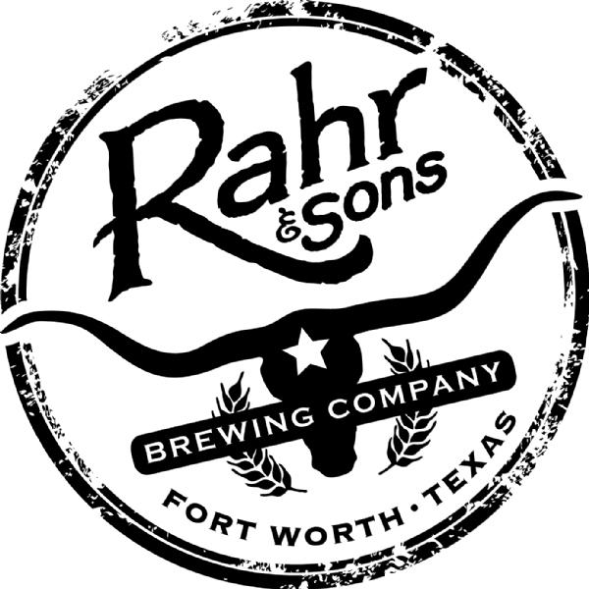
Brew-Forward 2019
Brewpub placement in the Dallas area

Slide 3
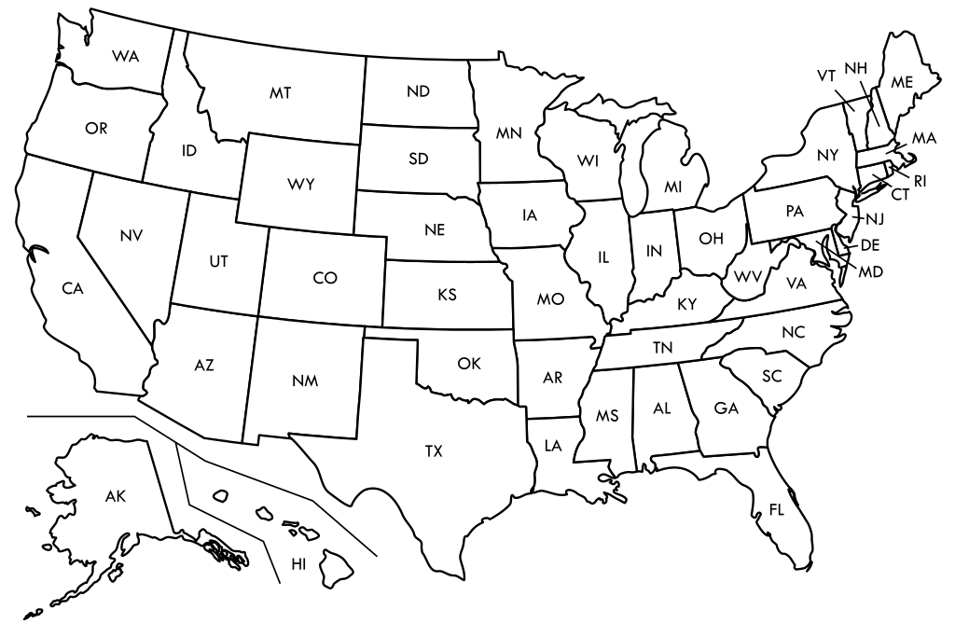
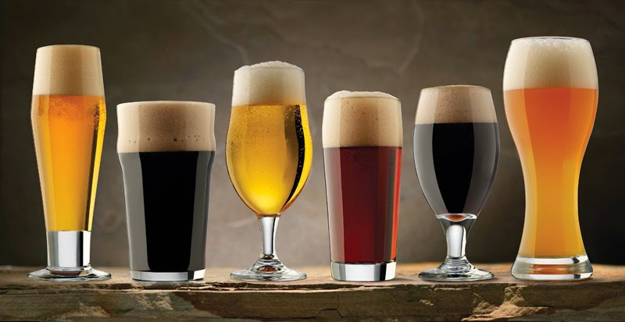



Recommend
Buy Humperdink’s Resturant with existing brewhosue
Establish membership program, offering mugs, food discounts, rewards for unique beers
High rotation of beers, instead of 30 standard offerings we offer 100 unique beers year around
Why
What
How
Strong age group between 28 to 36
High gross income in the park cities area of Dallas
Small Batch Brewpub
Allows for test batch development
Increase number of beers on rotation
Offer craft food & beer through a loyalty membership program.

Slide 4




Thank You
Chris Ballenger & Chad Madding
+1 555-0100
chris@rahrbrewing.com
rahrbrewing.com

